Slide 1
Real-time Anomaly Detection for Building Sensors Urban Data Lab Capstone Project Final Presentation
Data 599 Mitch Harris, Ryan Koenig, Nathan Smith June 22, 2021

Slide 2
Outline
Project Background
Methodology
Results
Challenges and Future Steps

Slide 3



MDS Project Team
Nathan Smith
Mitch Harris
Ryan Koenig

Slide 4
Project Background
Urban Data Lab
Project Description
Project Approach

Slide 5


Urban Data Lab (UDL) Project Background
Advance data access, data management and data analytics capabilities on UBC campus.
Open access of UBC sustainability data to researchers, policymakers and operational staff.
Supports the monitoring and measurement of sustainability performance for buildings, transportation, and natural assets.

Slide 6
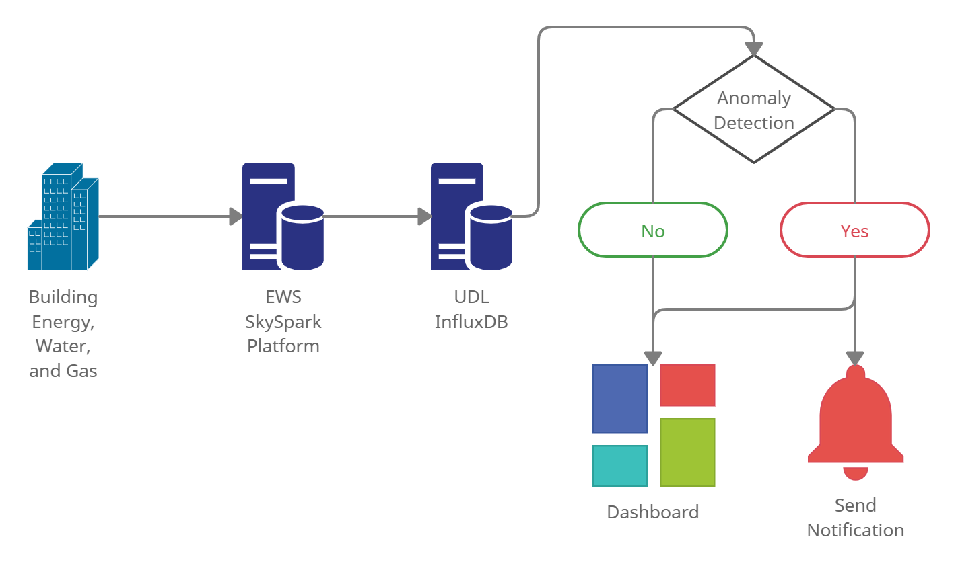
Description Project Background
UDL have noticed inconsistent/erroneous data – no system in place to identify this
UDL are interested in deployment of an anomaly detection system capable of notifying users of unusual behavior

Slide 7
Approach Project Background
Select subset of data to use for the study
Select real-time detection framework
Select anomaly detection model
Build pipeline for the anomaly detection model
Build dashboard/notification system
Model evaluation and tuning
Implement model/framework

Slide 8
Methodology
Select subset of data to use for the study
Select real-time detection framework
Select anomaly detection model
Build pipeline for the anomaly detection model
Build dashboard/notification system

Slide 9
Subset of Data Methodology
Campus Energy Center (CEC) Boiler Data
72 sensors available
Temperature, Pressure, Flow, Gas
Varying resolution (1 min – 15 min)
~2-4 years available

Slide 10
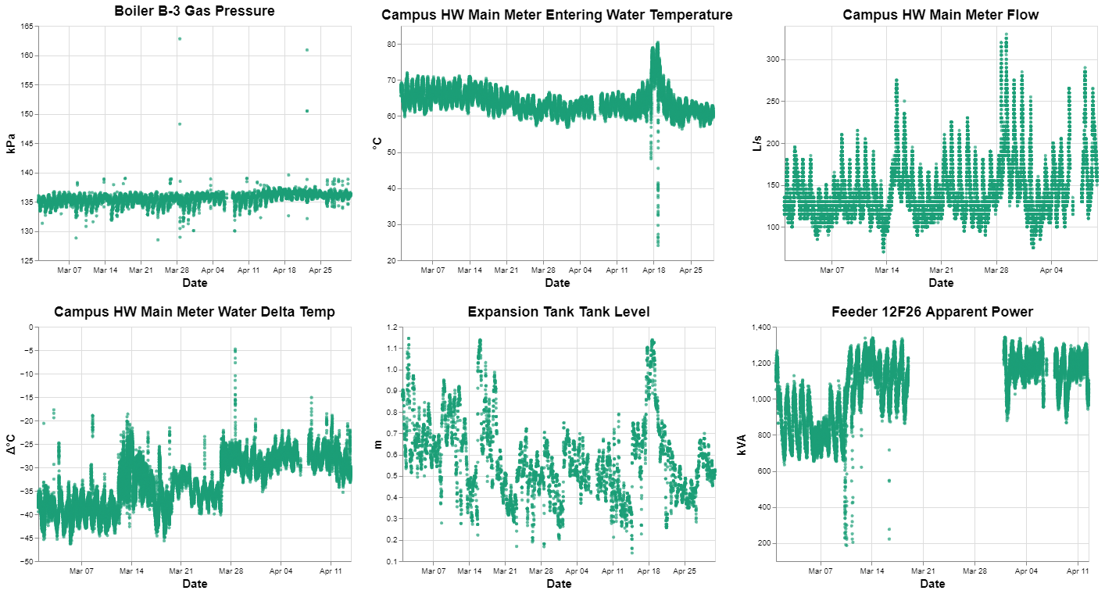
Subset of Data Current Progress
High variation in sensor patterns and anomalies types

Slide 11
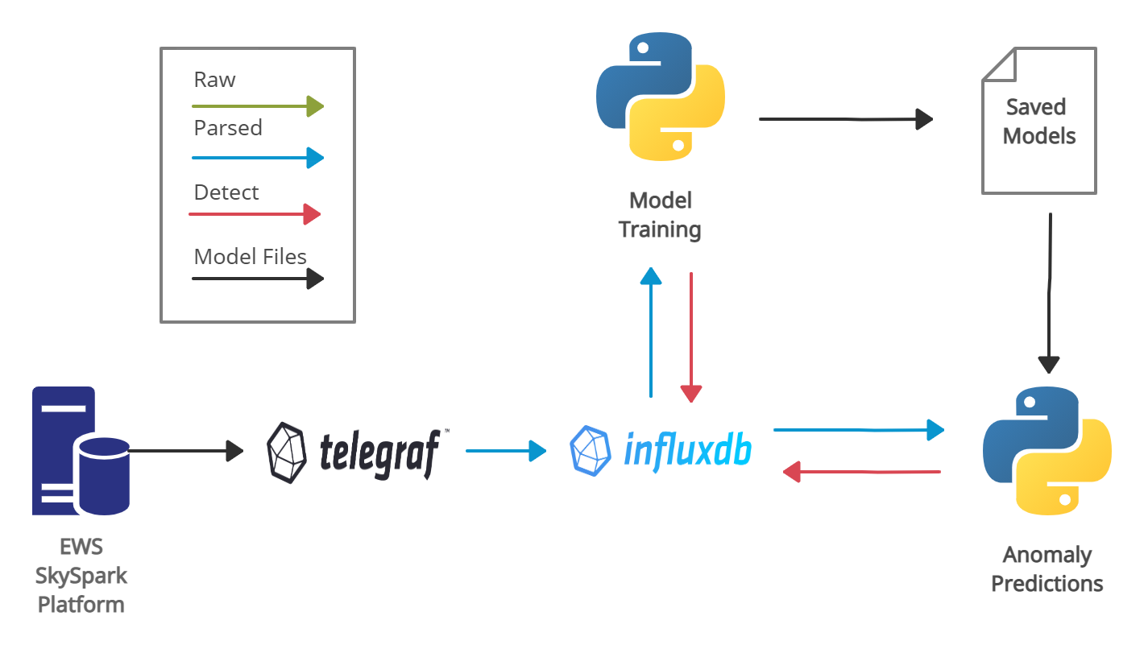
Real-time Detection Framework Methodology
Anomaly detection models are trained and parameters stored
Anomaly detector only reads latest points and uses stored models

Slide 12
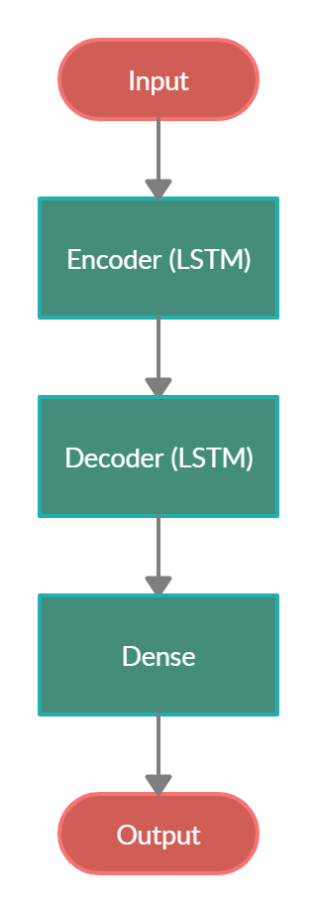
Anomaly Detection Model Methodology
LSTM Encoder-Decoder Model Selected
Identified as a successful model on IoT sensors
Able to run in an unsupervised approach
Flexible model to handle different sensor types
Has tunable parameters

Slide 13
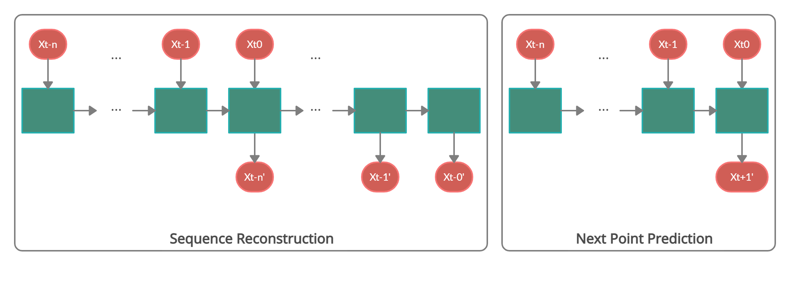
Anomaly Detection Model Methodology
Two Model Setups Considered
(Many-to-Many, Seq2Seq)
(Many-to-One)

Slide 14
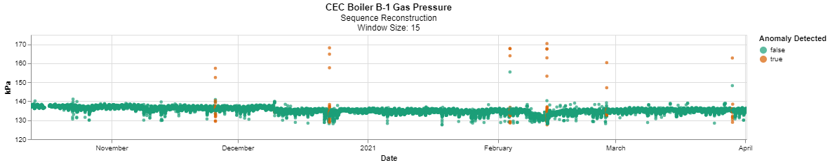
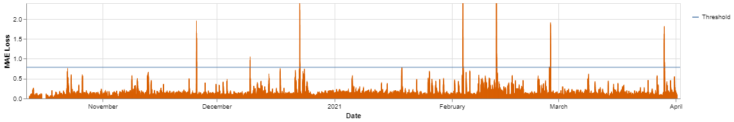
Anomaly Detection Model Methodology

Slide 15
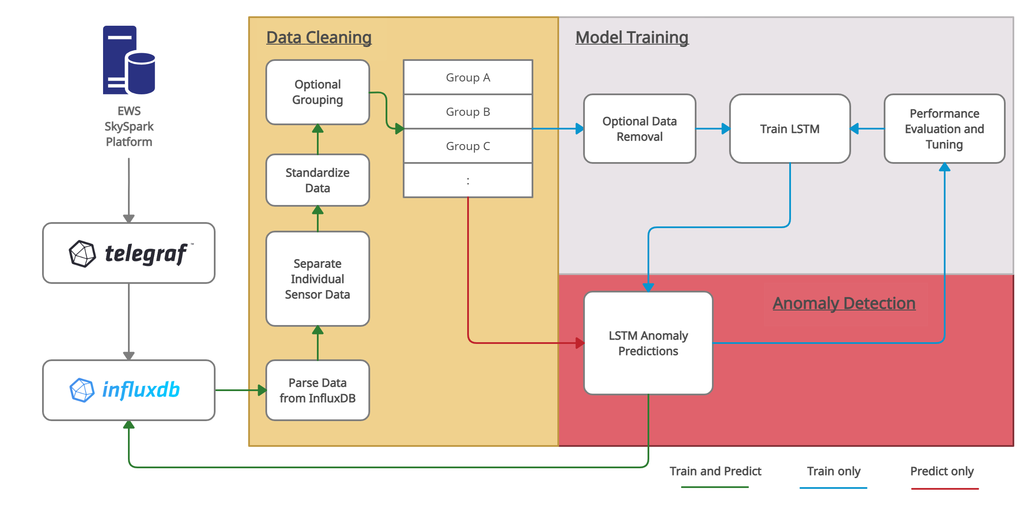
Model Pipeline Methodology

Slide 16
Model Pipeline Methodology
Data Processing
Data read and parsed from InfluxDB
Data standardized
Sensors individual or grouped
Data Removal
Erroneous sensor data can be removed
This is optional
LSTM-ED
General model that should be applicable to a wide variety of sensors
Tunable threshold for anomaly detection

Slide 17
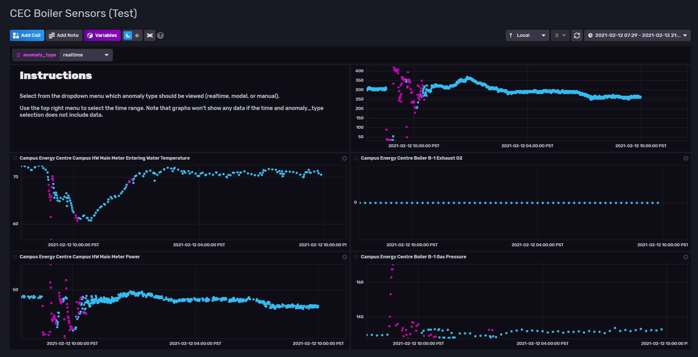
Dashboard and Notifications Methodology
Built directly into InfluxDB

Slide 18
Results
Testing Approach
LSTM-ED Performance
Test Environment Implementation

Slide 19
Testing Approach Results
Data labels not available, visually labelled 5 sensors
Phase 1 Testing:
Testing completed on 5 labelled sensors
Comparison of sequence reconstruction vs next point predictions
Testing various data input window sizes
Threshold method
Phase 2 Testing:
Test the best parameters from Phase 1 on additional sensors

Slide 20
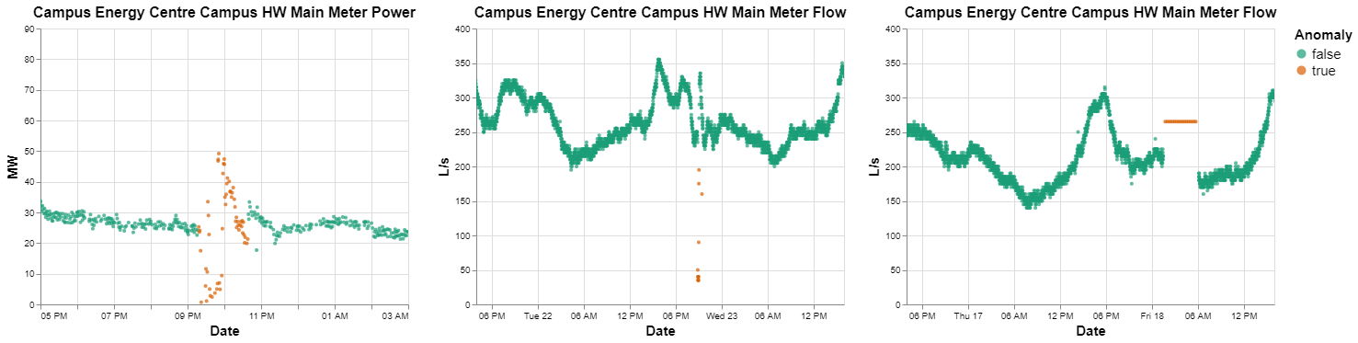
Manual Data Labelling Results
Qualitative and subjective but useful to help evaluate models in Phase 1 Testing

Slide 21


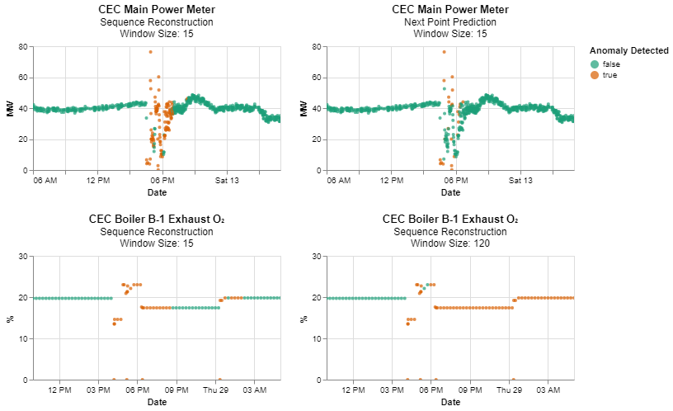
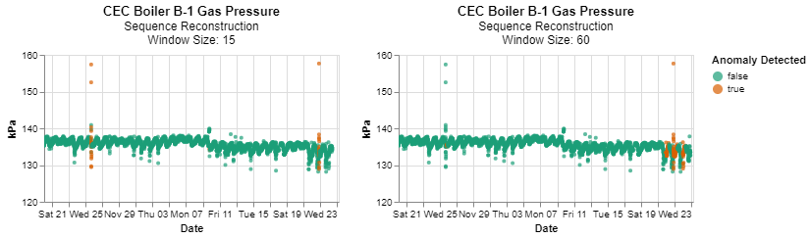
Phase 1 Testing Results
Next Point Prediction vs Sequence Reconstruction
Data Input Window Size

Slide 22
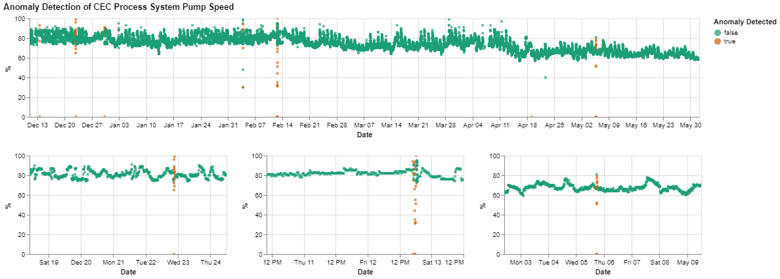
Phase 2 Testing Results
Good Performance using Phase 1 Testing Parameters

Slide 23
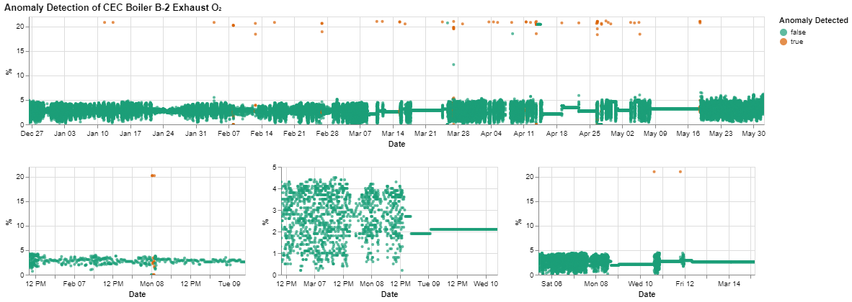
Phase 2 Testing Results
However, some instances where the model did not perform well

Slide 24
Test Environment Results
UDL InfluxDB Instance not yet operational with SkySpark data
Created a local InfluxDB test environment using Docker
Uploaded data simulating 5 sensors in InfluxDB
Tested model training (saving models)
Tested model predictions (loading models)
Setup dashboard and notification system

Slide 25
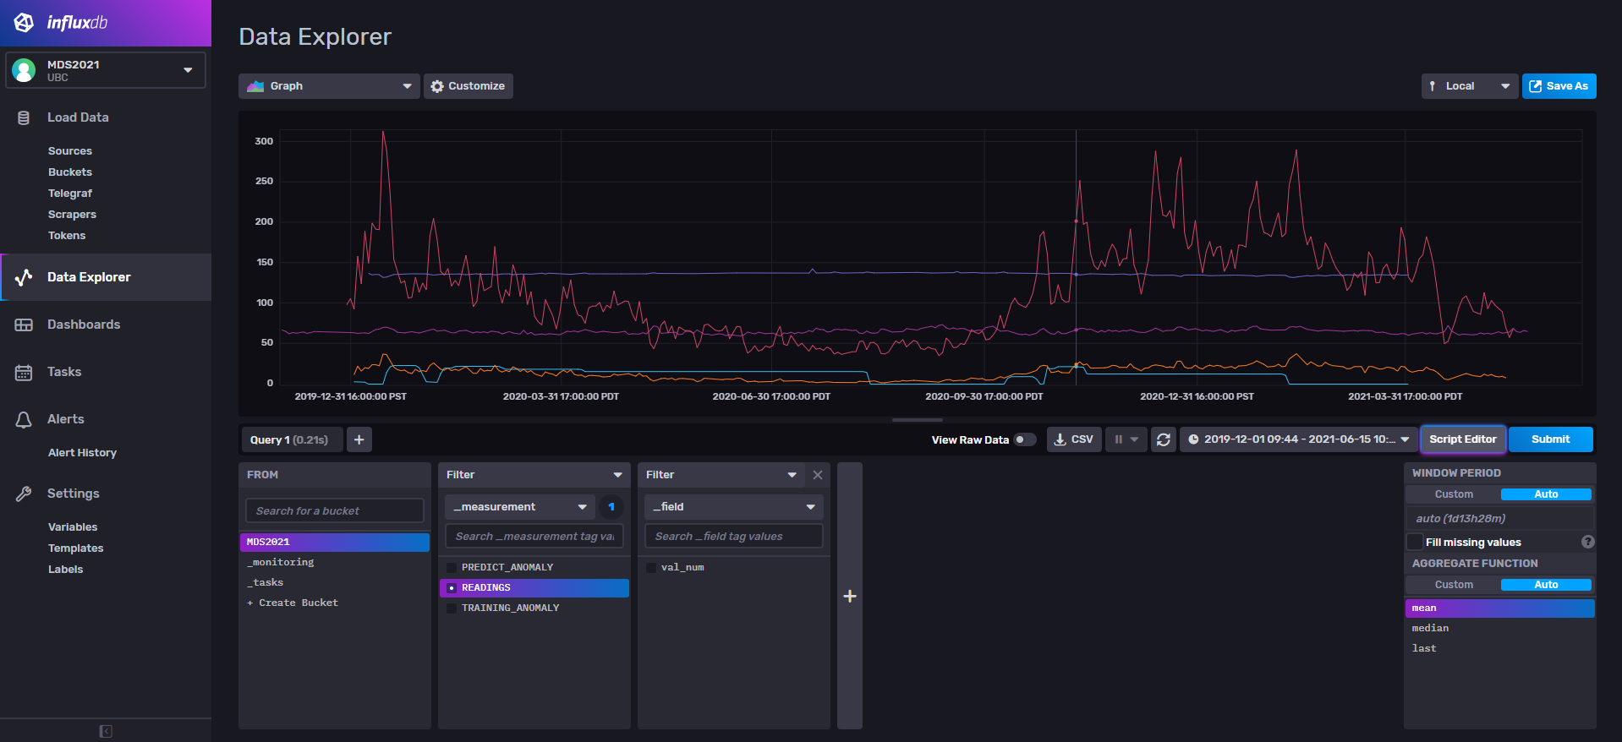
Test Environment Results

Slide 26
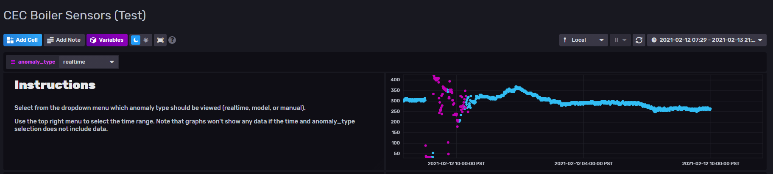

Test Environment Results
Provided anomalous data to test prediction, dashboard, and notification system

Slide 27
Challenges and Future Steps

Slide 28
Data Access Challenges
Historical or streaming data not currently available in InfluxDB
Support on parsing data using Telegraf
Manually downloading data was time consuming

Slide 29







Technology Challenges
A lot of tech to learn/explore in a short period

Slide 30
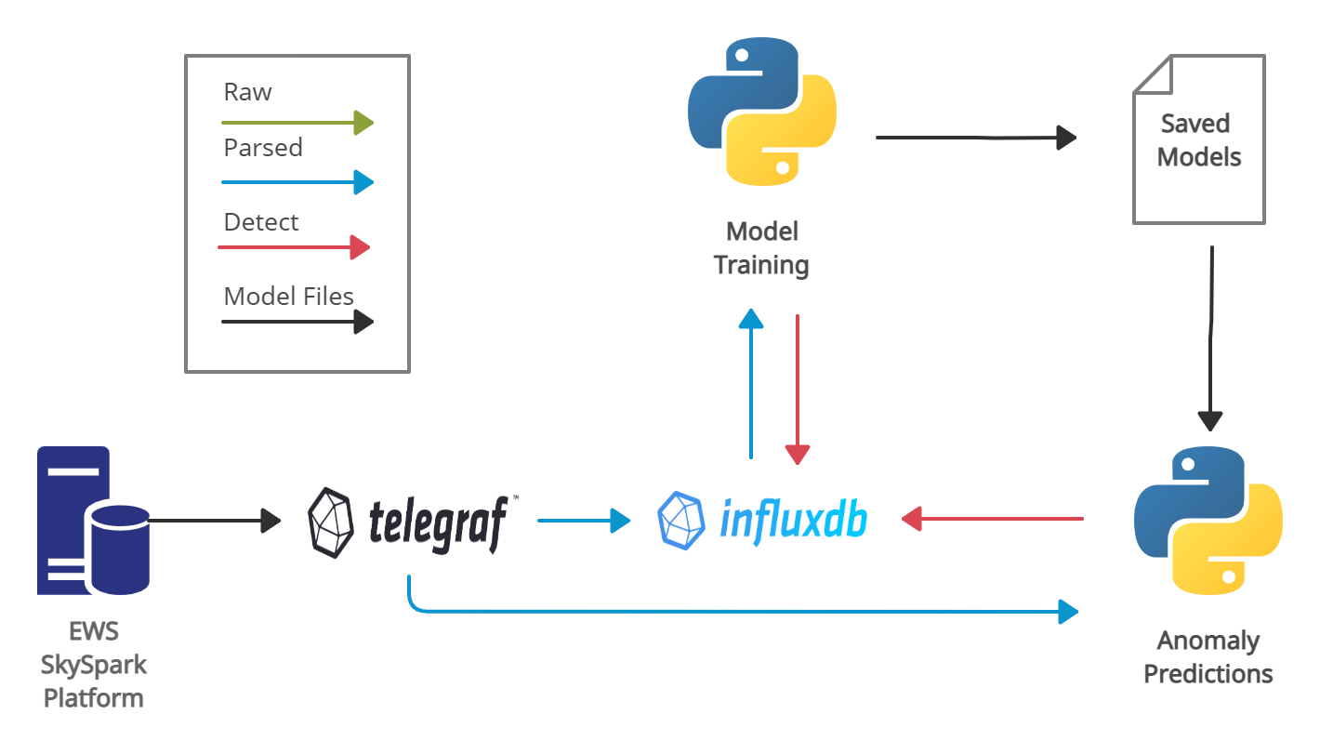
Anomaly Detection Framework Future Steps
Provide detection in-line with Telegraf

Slide 31
Anomaly Detection Model Future Steps
Improvements on the threshold selection method – biggest value here
Explore different types of models (such as ARIMA, bi-LSTM)
Look at options that are not open-source (such as Azure anomaly detection)
Notes:
To determine which values are anomalies, we used a simple maximum error threshold, anyway reconstruction error windows that exceed that threshold are flagged as anomalous. More sophisticated methods could look at more information such as the maximum error value such as the distribution of error within the window and if the error does not meet some expected distribution, it is flagged as anomalous.

Slide 32
Model Performance Future Steps
Apply specific model/rules for sensors where these are known inline with the LSTM-ED
Sensor grouping instead of just looking at individual sensors
Complete a quantitative assessment - requires sensors with anomalous data labels

Slide 33
Dashboard and Notification System Future Steps

Slide 34
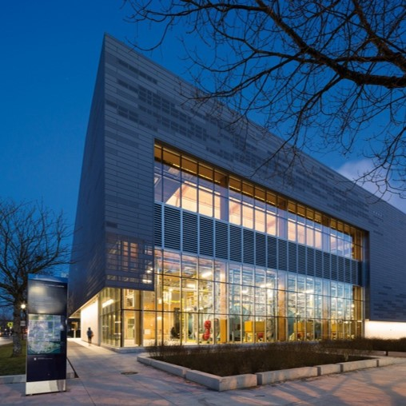
Acknowledgements
Urban Data Lab
UBC Energy and Water Services
Technical Safety BC
Mike Kennedy (UDL)
Jiachen Wei (UDL)
Ibrahim El-chami (UDL)
Scott Fazackerley (UBCO)
Irene Vrbik (UBCO)
Debangsha Sarkar (UBCO)

Slide 35
Q&A
Mitch Harris
Ryan Koenig
Nathan Smith

Slide 36
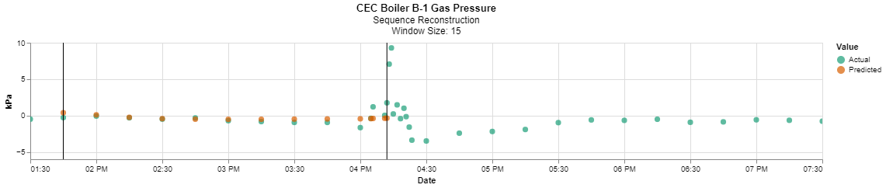
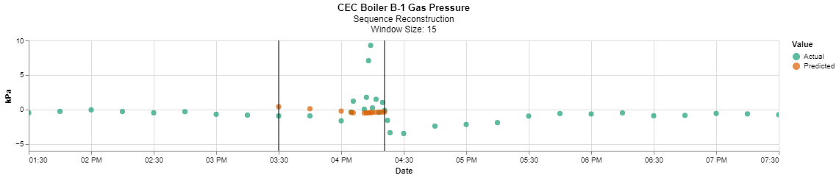
Anomaly Detection Model Methodology

